Slide 1
“Improving Impact-Based Seasonal Outlooks for South Central Texas”
Ty Dickinson
University of Oklahoma
Meteorology
Weather-Ready Nation
NWS San Antonio/Austin Weather Forecast Office
Larry Hopper and Mark Lenz, co-mentors
August 2017

Slide 2
Outline
Motivations
Objectives
Background
Results
Summary
Next Steps
Acknowledgements
Works Cited

Slide 3
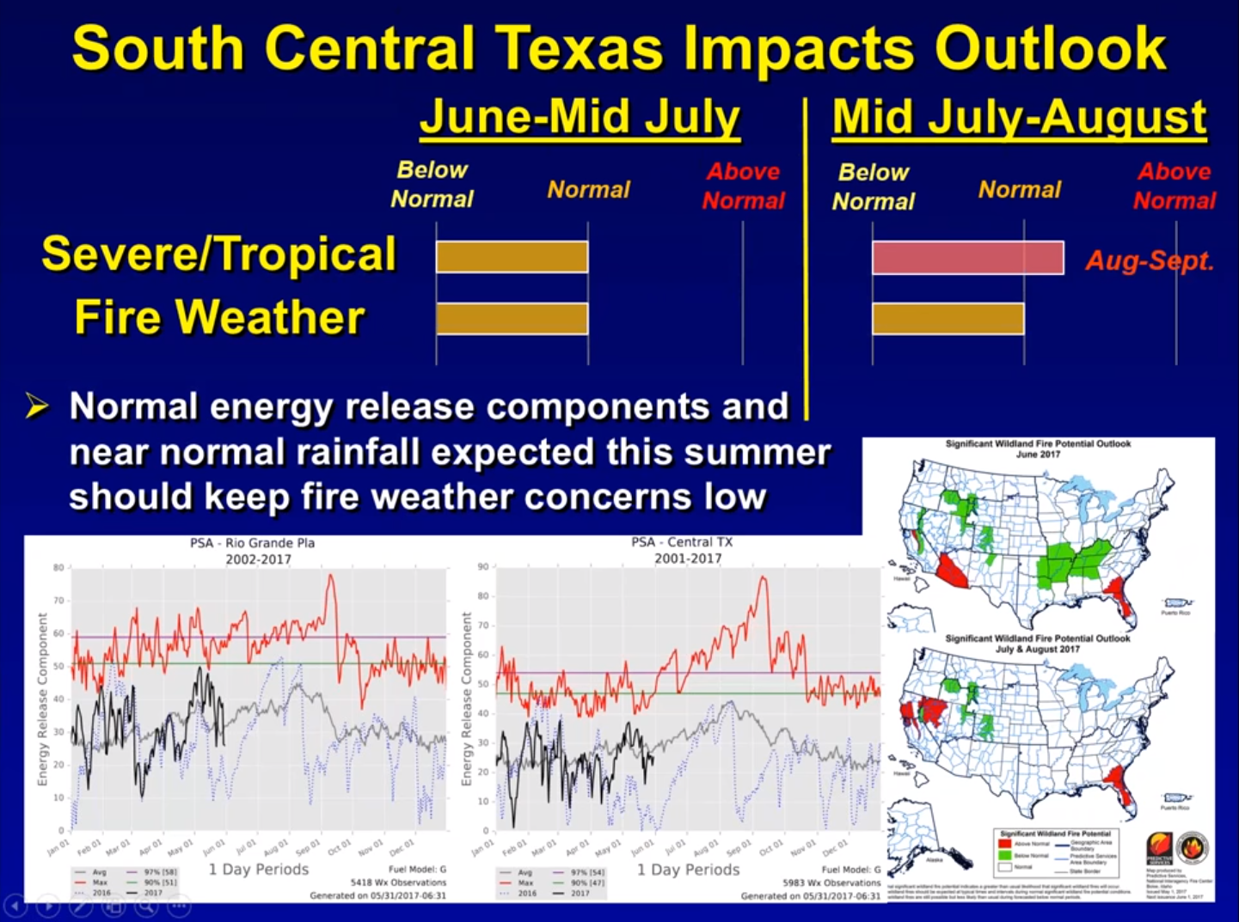
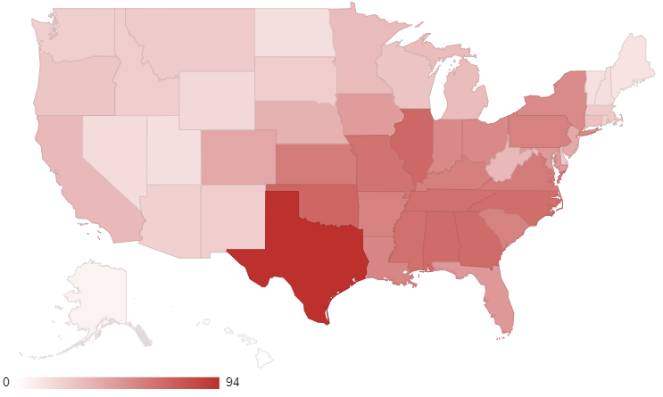
Motivations
As of July 7, 2017, Texas leads the U.S. in CPI-Adjusted Billion-Dollar Weather and Climate Disasters
  Record drought and subsequent flooding, most catastrophic wildfires and costliest hailstorm in state history since 2010
Beginning fall 2015, EWX produced quarterly seasonal outlooks for stakeholders to inform potential for upcoming season to be above normal, near normal, or below normal

Slide 4
Objectives
Events:
  Severe Weather
  River and Flash Flooding
  Fire Weather
  Winter Weather
Subjective vs. Objective forecasting
Verification indices made for each weather and climate event
  Modified Heidke Skill Score
  Ranked Probability Score

Slide 5
Background
Separation into winter (DJF), spring (MAM), summer (JJA), fall (SON)
List all relevant co-collaborators, i.e. other students, your mentors and co-mentors, etc.
Describe the approach or methodology
  What assumptions were made
  What is the anticipated outcome

Slide 6
Results
Discuss the results of your project.
  Was there a new finding? If so, describe and discuss its application in NOAA.
  Did your project contribute or support a larger NOAA effort?
  How did your project enhance existing knowledge or research in the NOAA office?

Slide 7
Summary
Summarize your project and results.

Slide 8
Next Steps
James Bruce Morehead Award at OU
  Expand to individual states, Southern Plains
  Integration into experimental developments of seasonal severe weather forecasts made by the SPC and CPC
  Meeting with WFO DTW to discuss application of winter weather process to regions with more experience
Use PRISM gridded data to eliminate assumptions made in using climate divisions
Add downriver streamflow as an indicator to river flooding

Slide 9
Acknowledgements
This project would not be were it is today without:
Larry Hopper and Mark Lenz, NWS WFO EWX for their guidance throughout.
The rest of the EWX staff for their generosity and helpfulness to whatever random question I threw at them
John Nielsen-Gammon, Texas A&M University, for offering incredible feedback on all aspects of the project
Scott Breit and Mike Dunivan, Texas A&M Forestry Service for giving feedback on drought and fire weather.
Matthew Rosencrans, CPC for aiding in the retrieval of archived seasonal outlooks.
Carolyn Pursley, Texas State Fire Marshal’s Office for providing the fire impacts dataset.
Brian Tomiuk, University of Michigan, and Justin Stipe, University of South Florida, for giving me ideas and helping me fix problems in writing Python scripts for the project.
and many others who I bounced ideas off of the past several months.

Slide 10
Works Cited
NOAA National Centers for Environmental Information (NCEI) U.S. Billion-Dollar Weather and Climate Disasters (2017). https://www.ncdc.noaa.gov/billions/

